Slide 1


LET’S BE READY,
LET’S BE EVERYWHERE,
LET’S BE A MAX!
SATURDAY, MARCH 18TH 2023 Data cleaning and second life of digital equipment
Name of the operation : ………………………………………….……………………………………………………….
Organiser(s) : …………………………………………………………….……………………………………………………….…………………….……
Meeting point : ………………………………………….……………………………………………………….
Contact(s) :
……………………… ………………………………..…….
Date/Time : ……………………… …………………………………….

Slide 2

LET’S BE READY,
LET’S BE EVERYWHERE,
LET’S BE A MAX!
SATURDAY, MARCH 18TH 2023 Data cleaning and second life of digital equipment
Name of the operation : ………………………………………….……………………………………………………….
Organiser(s) : …………………………………………………………….……………………………………………………….…………………….……
Meeting point : ………………………………………….……………………………………………………….
Contact(s) :
……………………… ………………………………..…….
Date/Time : ……………………… …………………………………….

Slide 3

LET’S BE READY,
LET’S BE EVERYWHERE,
LET’S BE A MAX!
SATURDAY, MARCH 18TH 2023 Data cleaning and second life of digital equipment
Name of the operation : ………………………………………….……………………………………………………….
Organiser(s) : …………………………………………………………….……………………………………………………….…………………….……
Meeting point : ………………………………………….……………………………………………………….
Contact(s) :
……………………… ………………………………..…….
Date/Time : ……………………… …………………………………….

Slide 4

LET’S BE READY,
LET’S BE EVERYWHERE,
LET’S BE A MAX!
SATURDAY, MARCH 18TH 2023 Data cleaning and second life of digital equipment
Name of the operation : ………………………………………….……………………………………………………….
Organiser(s) : …………………………………………………………….……………………………………………………….…………………….……
Meeting point : ………………………………………….……………………………………………………….
Contact(s) :
……………………… ………………………………..…….
Date/Time : ……………………… …………………………………….

Slide 5

LET’S BE READY,
LET’S BE EVERYWHERE,
LET’S BE A MAX!
SATURDAY, MARCH 18TH 2023 Data cleaning and second life of digital equipment
Name of the operation : ………………………………………….……………………………………………………….
Organiser(s) : …………………………………………………………….……………………………………………………….…………………….……
Meeting point : ………………………………………….……………………………………………………….
Contact(s) :
……………………… ………………………………..…….
Date/Time : ……………………… …………………………………….

Slide 6

LET’S BE READY,
LET’S BE EVERYWHERE,
LET’S BE A MAX!
SATURDAY, MARCH 18TH 2023 Data cleaning and second life of digital equipment
Name of the operation : ………………………………………….……………………………………………………….
Organiser(s) : …………………………………………………………….……………………………………………………….…………………….……
Meeting point : ………………………………………….……………………………………………………….
Contact(s) :
……………………… ………………………………..…….
Date/Time : ……………………… …………………………………….

Slide 7

LET’S BE READY,
LET’S BE EVERYWHERE,
LET’S BE A MAX!
SATURDAY, MARCH 18TH 2023 Data cleaning and second life of digital equipment
Name of the operation : ………………………………………….……………………………………………………….
Organiser(s) : …………………………………………………………….……………………………………………………….…………………….……
Meeting point : ………………………………………….……………………………………………………….
Contact(s) :
……………………… ………………………………..…….
Date/Time : ……………………… …………………………………….

Slide 8

LET’S BE READY,
LET’S BE EVERYWHERE,
LET’S BE A MAX!
SATURDAY, MARCH 18TH 2023 Data cleaning and second life of digital equipment
Name of the operation : ………………………………………….……………………………………………………….
Organiser(s) : …………………………………………………………….……………………………………………………….…………………….……
Meeting point : ………………………………………….……………………………………………………….
Contact(s) :
……………………… ………………………………..…….
Date/Time : ……………………… …………………………………….

Slide 9

LET’S BE READY,
LET’S BE EVERYWHERE,
LET’S BE A MAX!
SATURDAY, MARCH 18TH 2023 Data cleaning and second life of digital equipment
Name of the operation : ………………………………………….……………………………………………………….
Organiser(s) : …………………………………………………………….……………………………………………………….…………………….……
Meeting point : ………………………………………….……………………………………………………….
Contact(s) :
……………………… ………………………………..…….
Date/Time : ……………………… …………………………………….

Slide 10

LET’S BE READY,
LET’S BE EVERYWHERE,
LET’S BE A MAX!
SATURDAY, MARCH 18TH 2023 Data cleaning and second life of digital equipment
Name of the operation : ………………………………………….……………………………………………………….
Organiser(s) : …………………………………………………………….……………………………………………………….…………………….……
Meeting point : ………………………………………….……………………………………………………….
Contact(s) :
……………………… ………………………………..…….
Date/Time : ……………………… …………………………………….

Slide 11

LET’S BE READY,
LET’S BE EVERYWHERE,
LET’S BE A MAX!
SATURDAY, MARCH 18TH 2023 Data cleaning and second life of digital equipment
Name of the operation : ………………………………………….……………………………………………………….
Organiser(s) : …………………………………………………………….……………………………………………………….…………………….……
Meeting point : ………………………………………….……………………………………………………….
Contact(s) :
……………………… ………………………………..…….
Date/Time : ……………………… …………………………………….

Slide 12
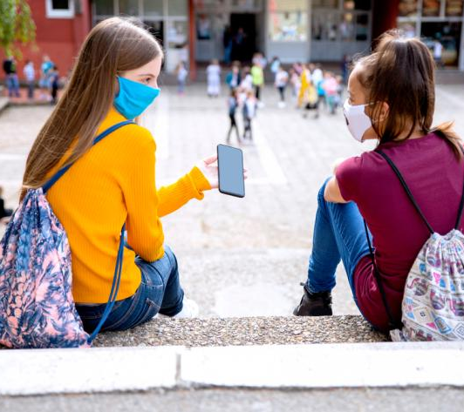
LET’S BE READY,
LET’S BE EVERYWHERE,
LET’S BE A MAX!
SATURDAY, MARCH 18TH 2023 Data cleaning and second life of digital equipment
Name of the operation : ………………………………………….……………………………………………………….
Organiser(s) : …………………………………………………………….……………………………………………………….…………………….……
Meeting point : ………………………………………….……………………………………………………….
Contact(s) :
……………………… ………………………………..…….
Date/Time : ……………………… …………………………………….

Slide 13

LET’S BE READY,
LET’S BE EVERYWHERE,
LET’S BE A MAX!
SATURDAY, MARCH 18TH 2023 Data cleaning and second life of digital equipment
Name of the operation : ………………………………………….……………………………………………………….
Organiser(s) : …………………………………………………………….……………………………………………………….…………………….……
Meeting point : ………………………………………….……………………………………………………….
Contact(s) :
……………………… ………………………………..…….
Date/Time : ……………………… …………………………………….

Slide 14
LET’S BE READY,
LET’S BE EVERYWHERE,
LET’S BE A MAX!
SATURDAY, MARCH 18TH 2023 Data cleaning and second life of digital equipment
Name of the operation : ………………………………………….……………………………………………………….
Organiser(s) : …………………………………………………………….……………………………………………………….…………………….……
Meeting point : ………………………………………….……………………………………………………….
Contact(s) :
……………………… ………………………………..…….
Date/Time : ……………………… …………………………………….

