Slide 1

YOUR LOGO ou NAME OF YOUR EVENT
14 - 19 march 2022
Cyber World CleanUp Day • 3rd edition https://cyberworldcleanupday.fr/welcome/
Notes:
OK

Slide 2
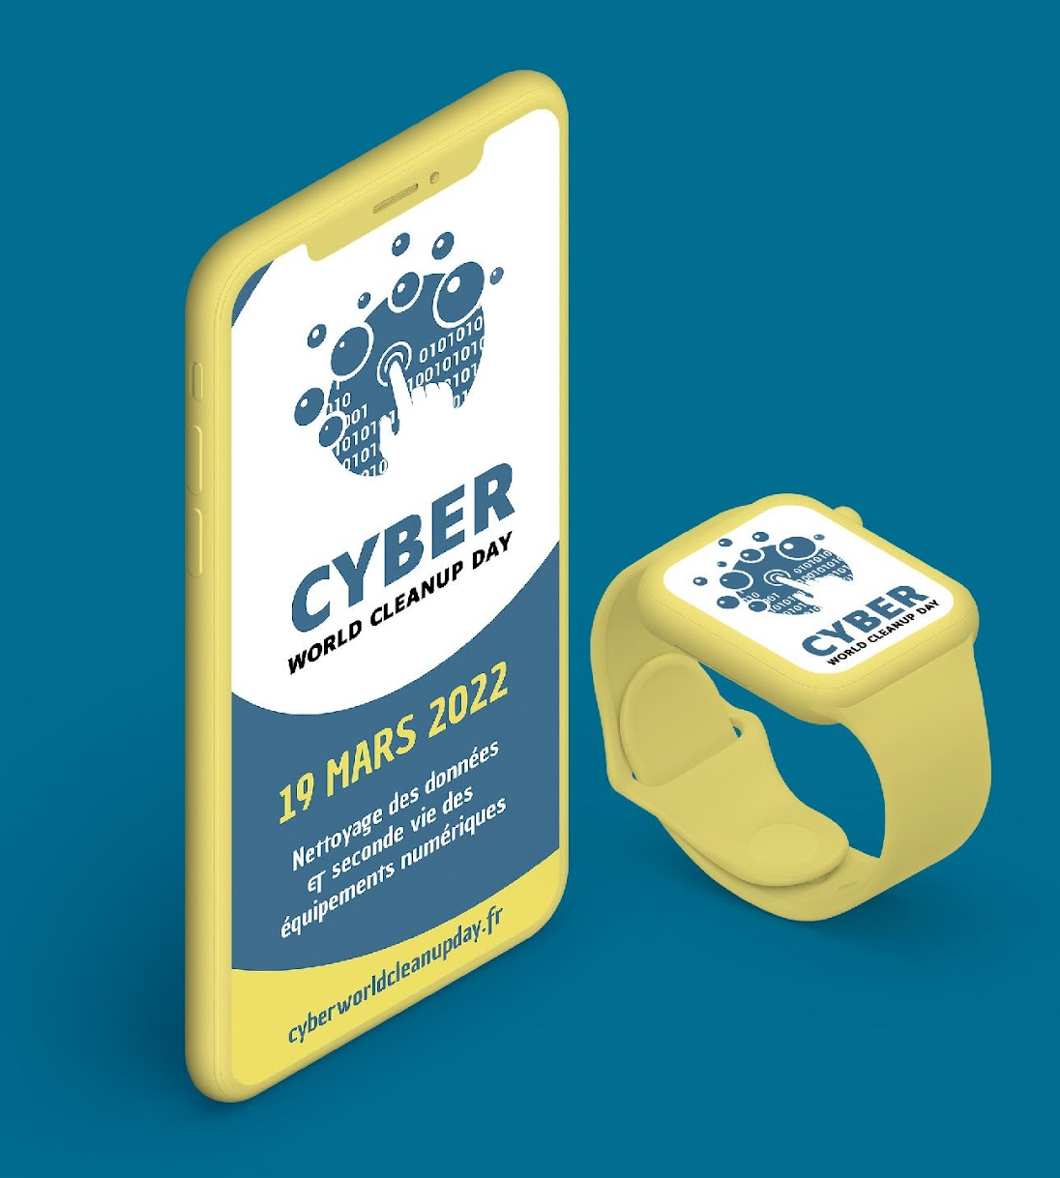


Name Last name
Who are you ?
Welcome!
#CyberWCUD • 3rd edition
19 march 2022 session
Notes:
OK

Slide 3
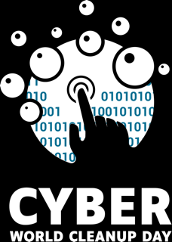
Summary
I Digital technology and its impact p 4
I Presentation of the Cyber WCUD Project p 23
I 2 Categories of Cyber CleanUp p 27
I Action ! Cyber CleanUp Data p 28
I Action ! Cyber CleanUp Equipments p 47
I And after that?! p 57
Notes:
OK

Slide 4



I Digital technology and its impact
The Paris Agreement, to stay
below 2°C of warming implies to :
Halve our CO2 emissions by 2030
Divide them by 5 by 2050
Yet it is growing rapidly
and it is already 4% of GH …
Technology must do its part!
Notes:
OK

Slide 5

I Exponential growth
+ and +
+ and +
+ and +
of data produced and/or transferred per equipment
users of digital technology and internet users
of digital equipment per user
Manufacturing
Non-Renewable Resources
Water
Soil and Water Pollution
Primary Energy
Notes:
OK

Slide 6


1 I Statement
How much do you know about the impact of digital technology? - Quiz
Notes:
Moment d’échange

Slide 7

What is the proportion in % of GHG* emissions emitted by the digital sector in the world?
*Greenhouse gases.
QUESTION
#1
Notes:
OK

Slide 8
4%
of GHGs are emitted by the digital technology sector, which is much more than civil aviation !*
*Source : GreenIT Report - 2019
ANSWER
#1
Notes:
OK

Slide 9
What percentage of the world's electricity production is digital technology?
QUESTION
#2
Notes:
OK

Slide 10
ANSWER
#2
10%
of the world's electricity production is mobilized for digital technology.*
*Source : ADEME 2019
Notes:
OK

Slide 11

How many digital devices (computers, smartphones, consoles, TV...) are used in the world?
QUESTION
#3
Notes:
OK

Slide 12
34 billions
of equipment are currently in service in the world!*
*Source : GreenIT Report 2019
ANSWER
#3
An inhabitant of Western Europe will own on average 9 electronic devices in 2021
(Source ADEME 2021)
Notes:
OK

Slide 13

How many materials make up a 5.5-inch smartphone ?
QUESTION
#4
Notes:
OK

Slide 14
70 materials
to be extracted are necessary for the manufacture !*
And these resources are not infinite!
Some are already almost exhausted (Silver, Gold, Lead, Copper ... by 2030) - and extracted in rare earth mines with catastrophic human consequences.
*Source : ADEME 2019
ANSWER
#4
Notes:
OK

Slide 15
I The environmental impact of digital technology
4%
90%
20%
1%
of CO2 emissions emissions in 2019 are digital technology related.
This figure could rise to 8% by 2025.
of the carbon impact of the mobile phone is linked to its manufacture
It takes at least 5 years of use for the environmental impact of the smartphone to be equivalent to that of its manufacture.
of WEEE (Waste Electrical and Electronic Equipment) is documented as having been collected and recycled through appropriate channels.
Interpol estimates that 70% of European WEEE is diverted for illegal trafficking
the recycling technology is not yet perfected: less than 1% of the metals in digital technology are actually recycled.
95% of rare earths are produced in China.
Source : The Shift Project
Ademe Study - nov 2019
Source : The Shift Project
Source : Université ONU - 2016
Science et Avenir - juin 2015
Source : « La guerre des métaux rares » Guillaume Pitron - 2018
Notes:
OK

Slide 16

I The impacts of the IT sector
69%
7 to 10%
80 times
of French people want to moderate their digital use
The primary use of digital technology is now on the mobile. In France, we use our mobile phone for more than 50 hours a month. 90% of this time is spent consulting the Internet.
of the world's electricity is consumed by the internet alone.
If the Internet were a country it would be the world's 3rd largest consumer of electricity after China and the USA.
more energy is needed to produce 1 gram of smartphone than 1 gram of car.
The 34 billion smartphones, computers, games consoles and TVs on the planet are central to the environmental impact.
Source : Baromètre du numérique 2019 - ARCEP
Source : Rapport Clicking Clean Greenpeace 2017
Source : Etude Green IT Nov 2019
Notes:
OK

Slide 17

2
Give our equipment a second life !
& clean up our data !
Presentation of the project
#CyberWCUD2022 3rd edition
Notes:
OK

Slide 18

The objective of Cyber World CleanUp Day is to create the conditions for a global awareness of the environmental impact of digital technology for the preservation of our environment and biodiversity.
This project, co-organised by Institute for Sustainable IT and World Cleanup Day France is part of a crazy but bold global effort to coordinate 180 countries and 5% of the world's population to clean up the world's digital data.
I What is the concept?
One day (or a little more, the period allocated for participants is from 14 to 19 March 2022) to delete data stored in the Cloud, on common servers and on all our digital equipment, but also to repair or promote the re-use of our obsolete equipment, or recycle our electronic waste (WEEE) to reduce our digital technology footprint.
More information : https://cyberworldcleanupday.fr/
Notes:
OK

Slide 19
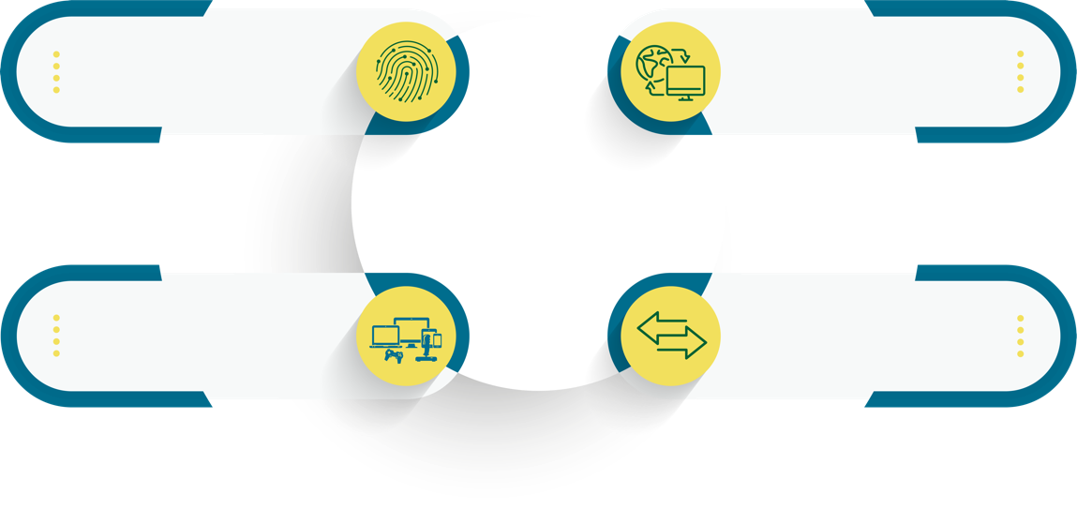

I PURPOSE
Raise awareness of the environmental footprint of digital technology
Helping to consume less equipment and storage space
Helping to extend the life of digital equipment or giving it a second life.
Contribute to changing habits in the production and transfer of data
Notes:
OK

Slide 20
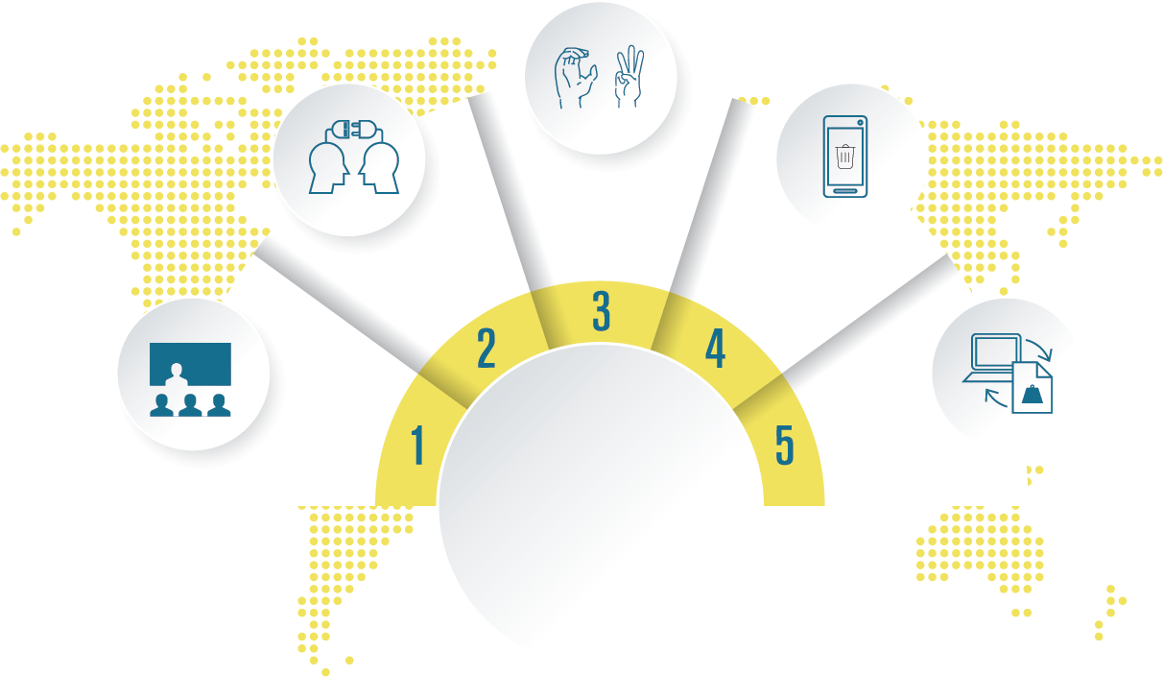
I Objectives
Conviviality
Federate
Hire the first step
Raising awareness
Measure
Notes:
1. Sensibiliser : L’objectif premier de ce projet est de sensibiliser avec une action simple, concrète et accessible à tous.
2. Fédérer : Accessible à tous car nous souhaitons fédérer l’ensemble des acteurs “externes”, les Associations, les Ecoles, Les Entreprises, les Collectivités et les Citoyens. Mais aussi les acteurs “internes” autour d’un projet Numérique Responsable, c’est à dire vos collaborateurs
3. Convivialité : Nous vous avons invité à effectuer cette action et cette sensibilisation autour d’un événement de type atelier ou conférence pour favoriser les échanges et éviter de se retrouver seul derrière son PC.
4. Engager le 1er pas : C’est passer à l’action ! C’est commencer sa démarche Numérique Responsable … Commencer par quelque de simple comme nettoyer ses données et supprimer ce qui est devenu inutiles ou obsolète.
5. Mesurer : C’est pouvoir concrétiser l’effort fourni par chacun et renforcer la prise de conscience à titre individuel. C’est pouvoir afficher l’impact du projet tel que nous allons vous présenter les résultats dans le cadre de ce webinaire.

Slide 21
I 2 Categories of Cyber CleanUp
3
For this 2022 edition, 2 categories of Cyber CleanUp :
Cyber CleanUp Data: let's clean up our data!
Cyber CleanUp Equipment : give a second life to our digital equipment!

Slide 22
Action !
Cyber CleanUp Data
#CyberWCUD2022
Notes:
OK

Slide 23
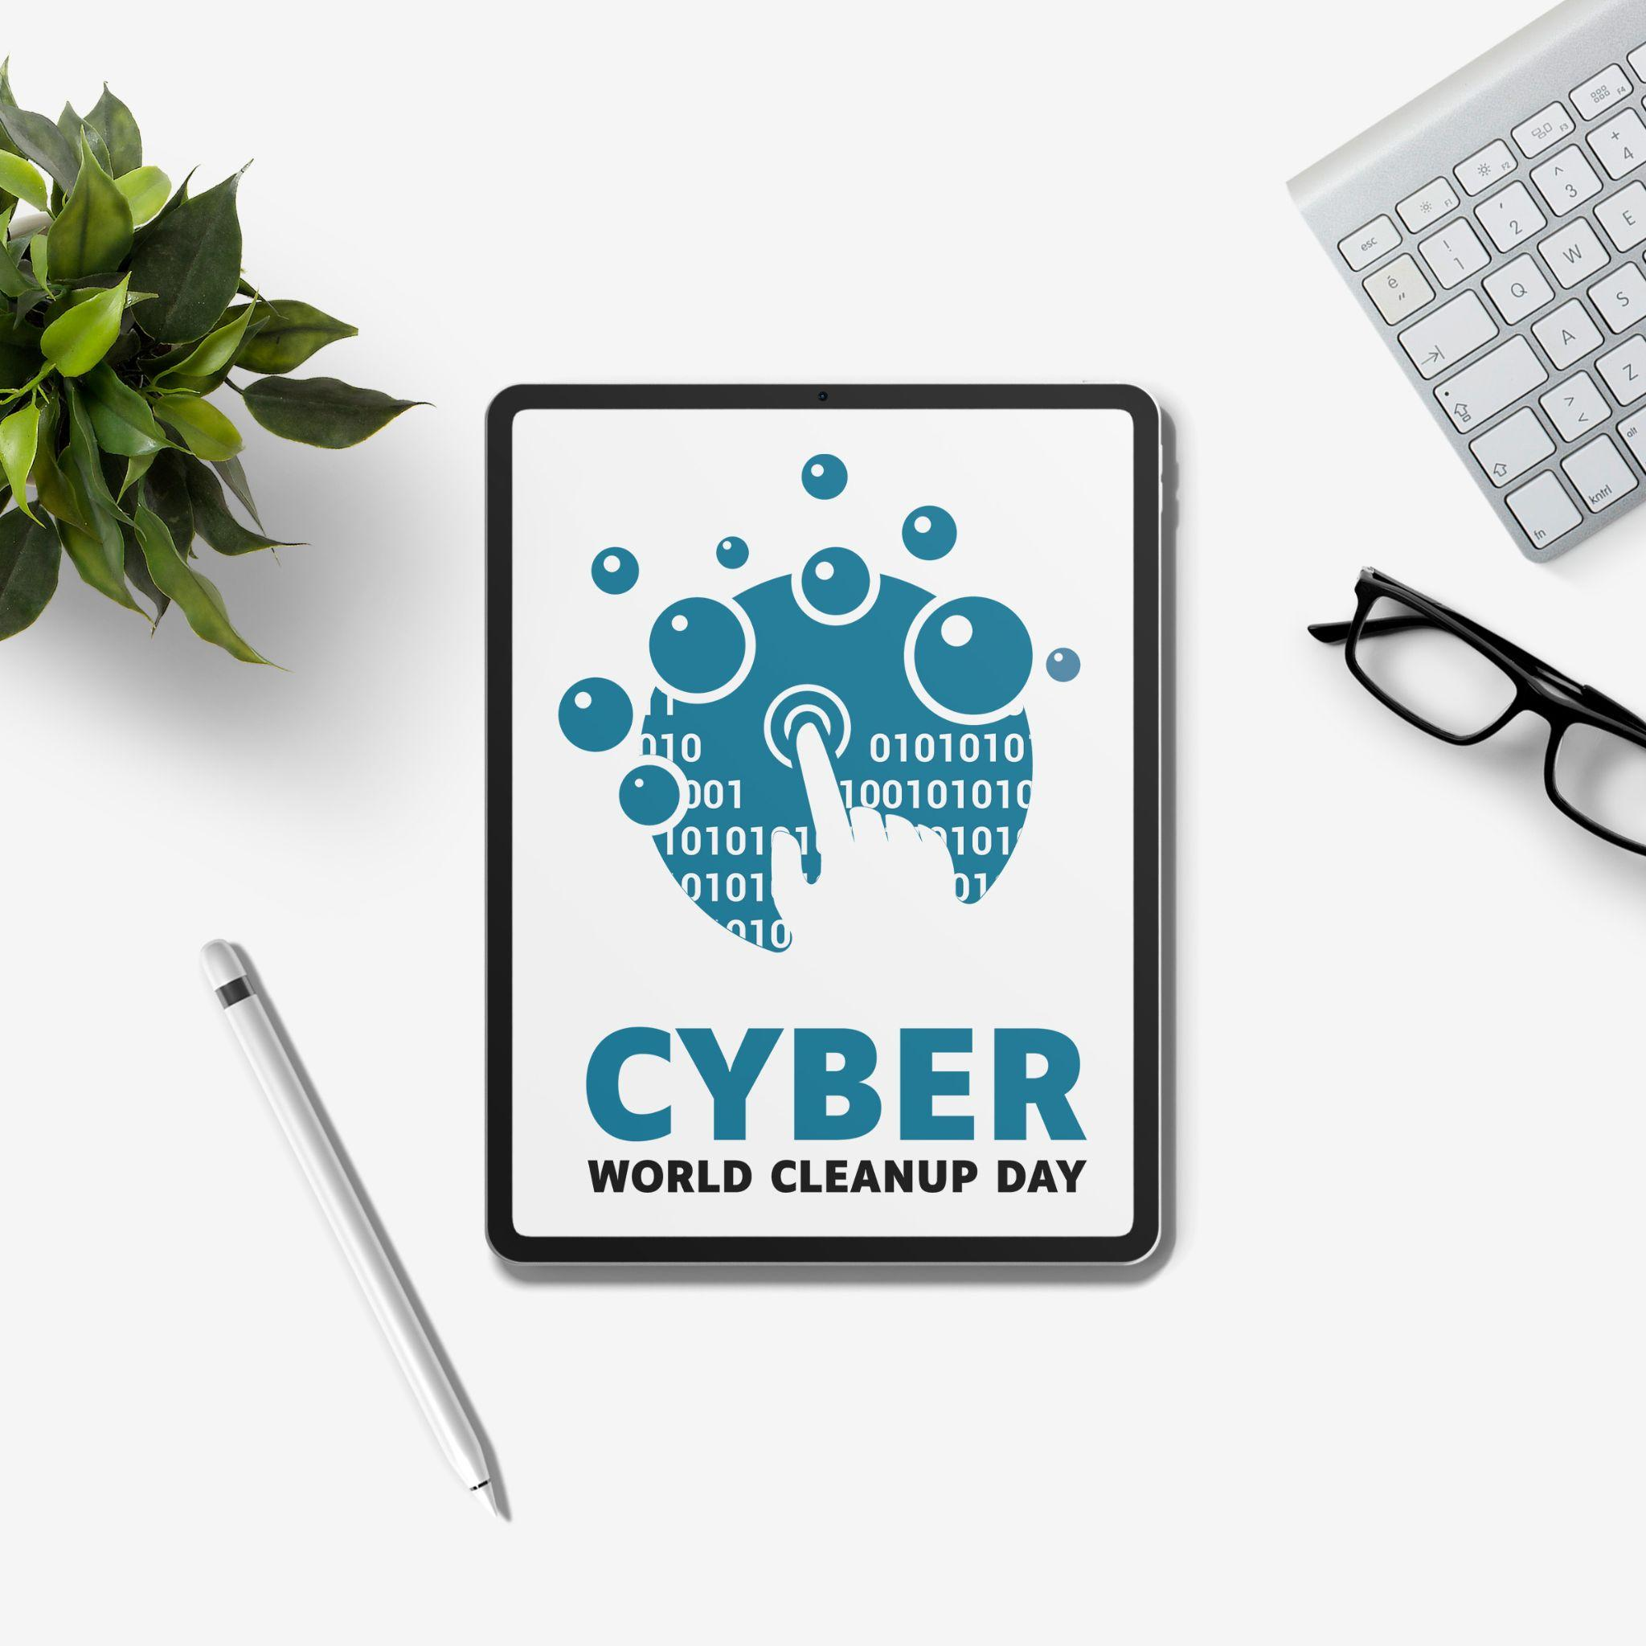
Why it is important to clean up your data ?
Accumulating data on your smartphone or computer accelerates the planned obsolescence of your equipment and increases the storage capacity required in data centers.
Cleaning your smartphone or computer means lightening your equipment, improving its performance and extending its lifespan !
Notes:
OK

Slide 24
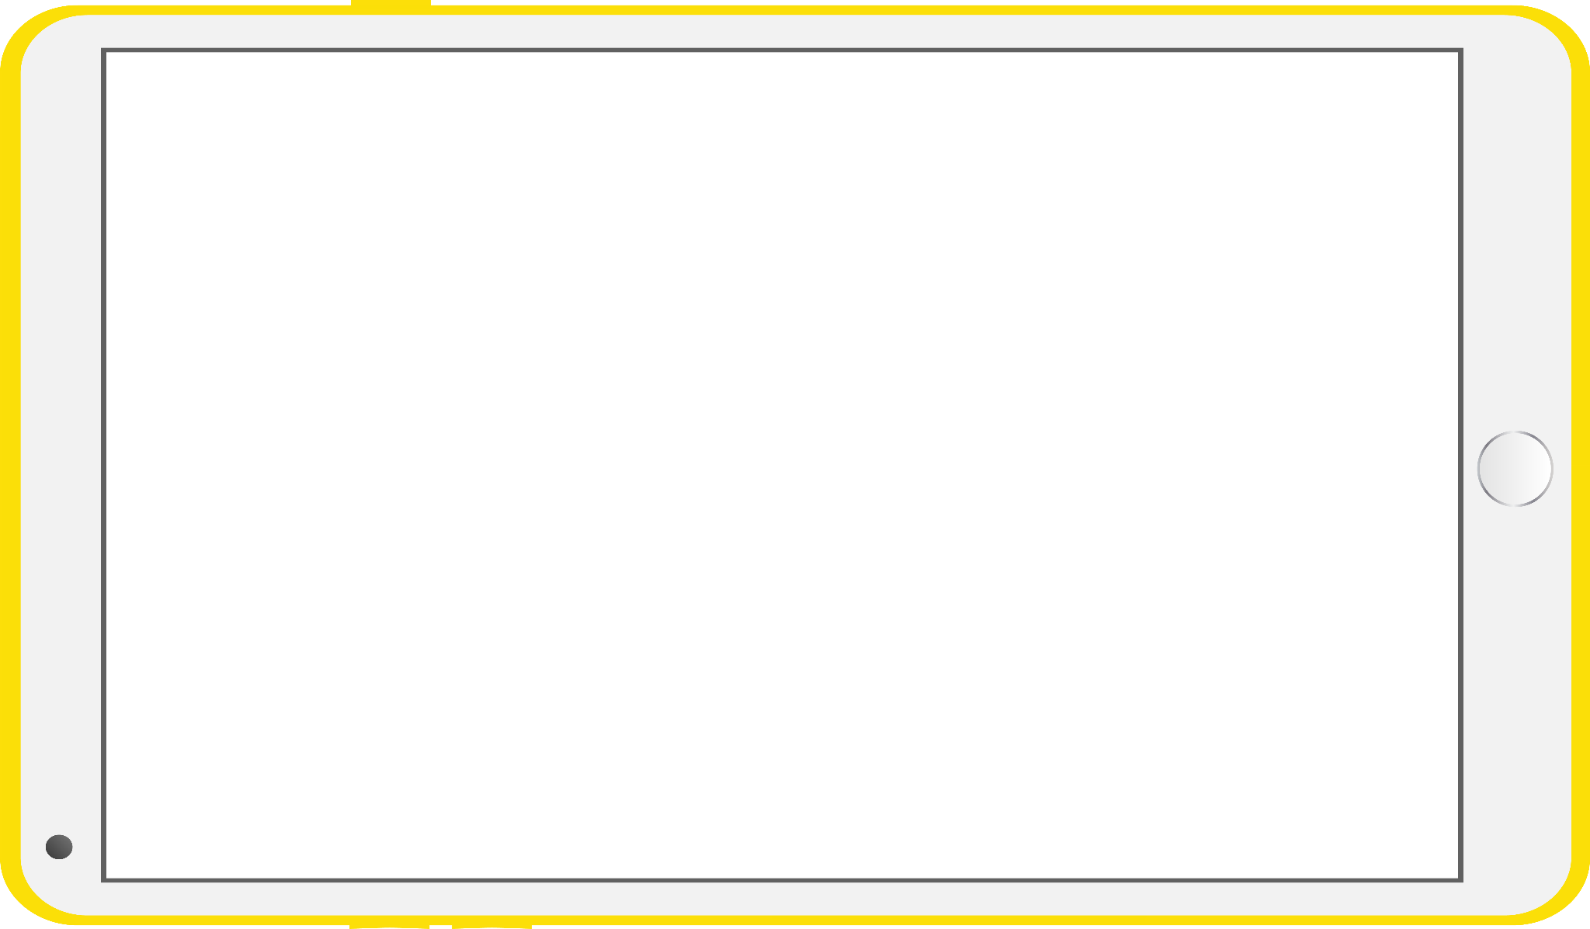



Our Cyber CleanUp Data scope
Our mailboxes
Our computers, servers or cloud data
Our phones and tablets
Our social media
Notes:
OK

Slide 25
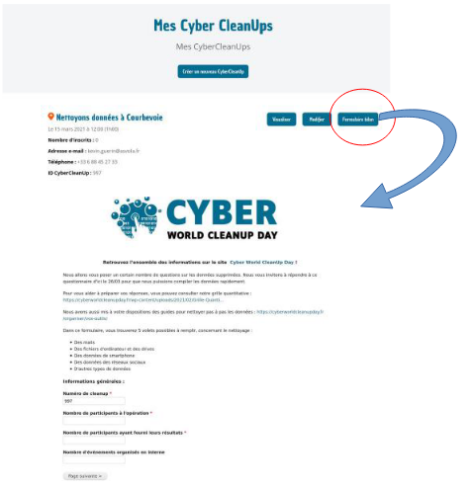
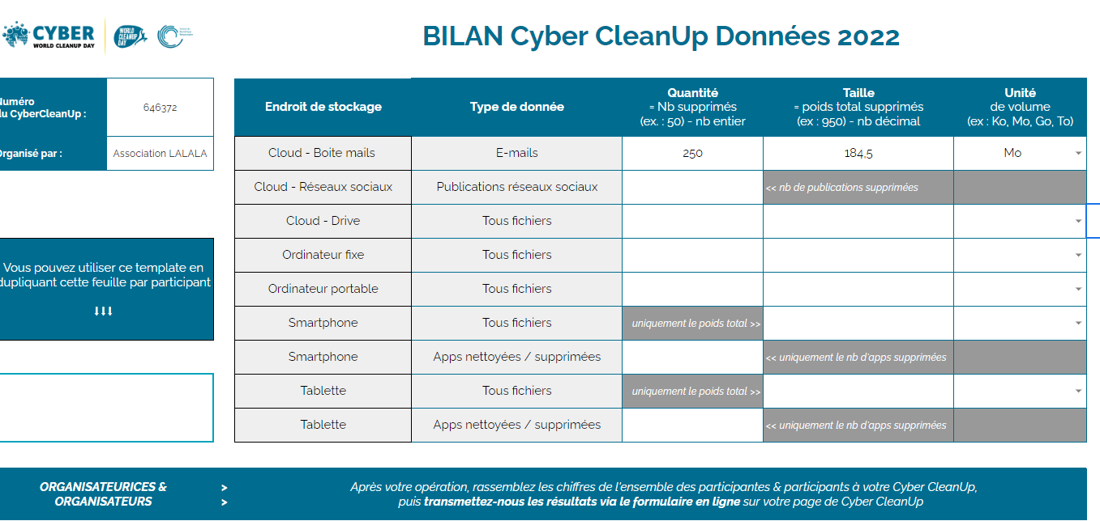
Et toujours
I Outcome
Data to be measured :
Number of deleted emails
Weight of emails
Number of social media publications deleted
Number of deleted cloud files (docs, photos, videos...)
Weight of cloud files
Number of files on your computers deleted
Number of applications cleaned or deleted (tablets / smartphones)
Weight of local data (computer, smartphone, tablet) deleted
Notes:
OK https://docs.google.com/spreadsheets/d/1h-w0Pd6AtrnW4ha_X5667Rfn1K5OkFMZThlE1x6xO4o/edit#gid=2116930099

Slide 26
What if we cleaned up our emails?
Notes:
OK

Slide 27
To measure the impact of the event, please indicate at the end of this exchange the number and weight of emails you have deleted !
To begin with, let's make a diagnosis of the storage space used on your mailbox :
In Outlook
→ Settings > General > Storage or File > Tools to view the currently used storage space
In Gmail
→ Information visible at the bottom of the screen or under Profile picture > Manage your Google Account
> Storage space associated with your account > Manage storage space
And don't forget to empty the recycle bin if you haven't already done so
More in the guide on cleaning up emails
Notes:
OK

Slide 28

I Clean up your emails
Sort and delete my emails
1 - Start by deleting the heaviest emails by sorting them by weight or attachment
2 - Delete categories of similar mails (past projects, automatic mails etc)
3 - Keep only the last message of a conversation.
02
Tidy up my emails
1- Tidying up your e-mails allows you to identify more quickly which e-mails are important to keep and which do not need to be kept
2 - Perhaps you identify e-mails that you never read?
01
Developing new habits
1 - Write emails as lightly as possible: target recipients, compress attachments or use links or a temporary repository site and use instant messaging or the telephone instead.
2 - Set up rules for automatic emptying of the bin.
3 - Unsubscribe from unread newsletters or use RSS feeds instead
4 - Inbox Zero Method
03
Notes:
OK

Slide 29
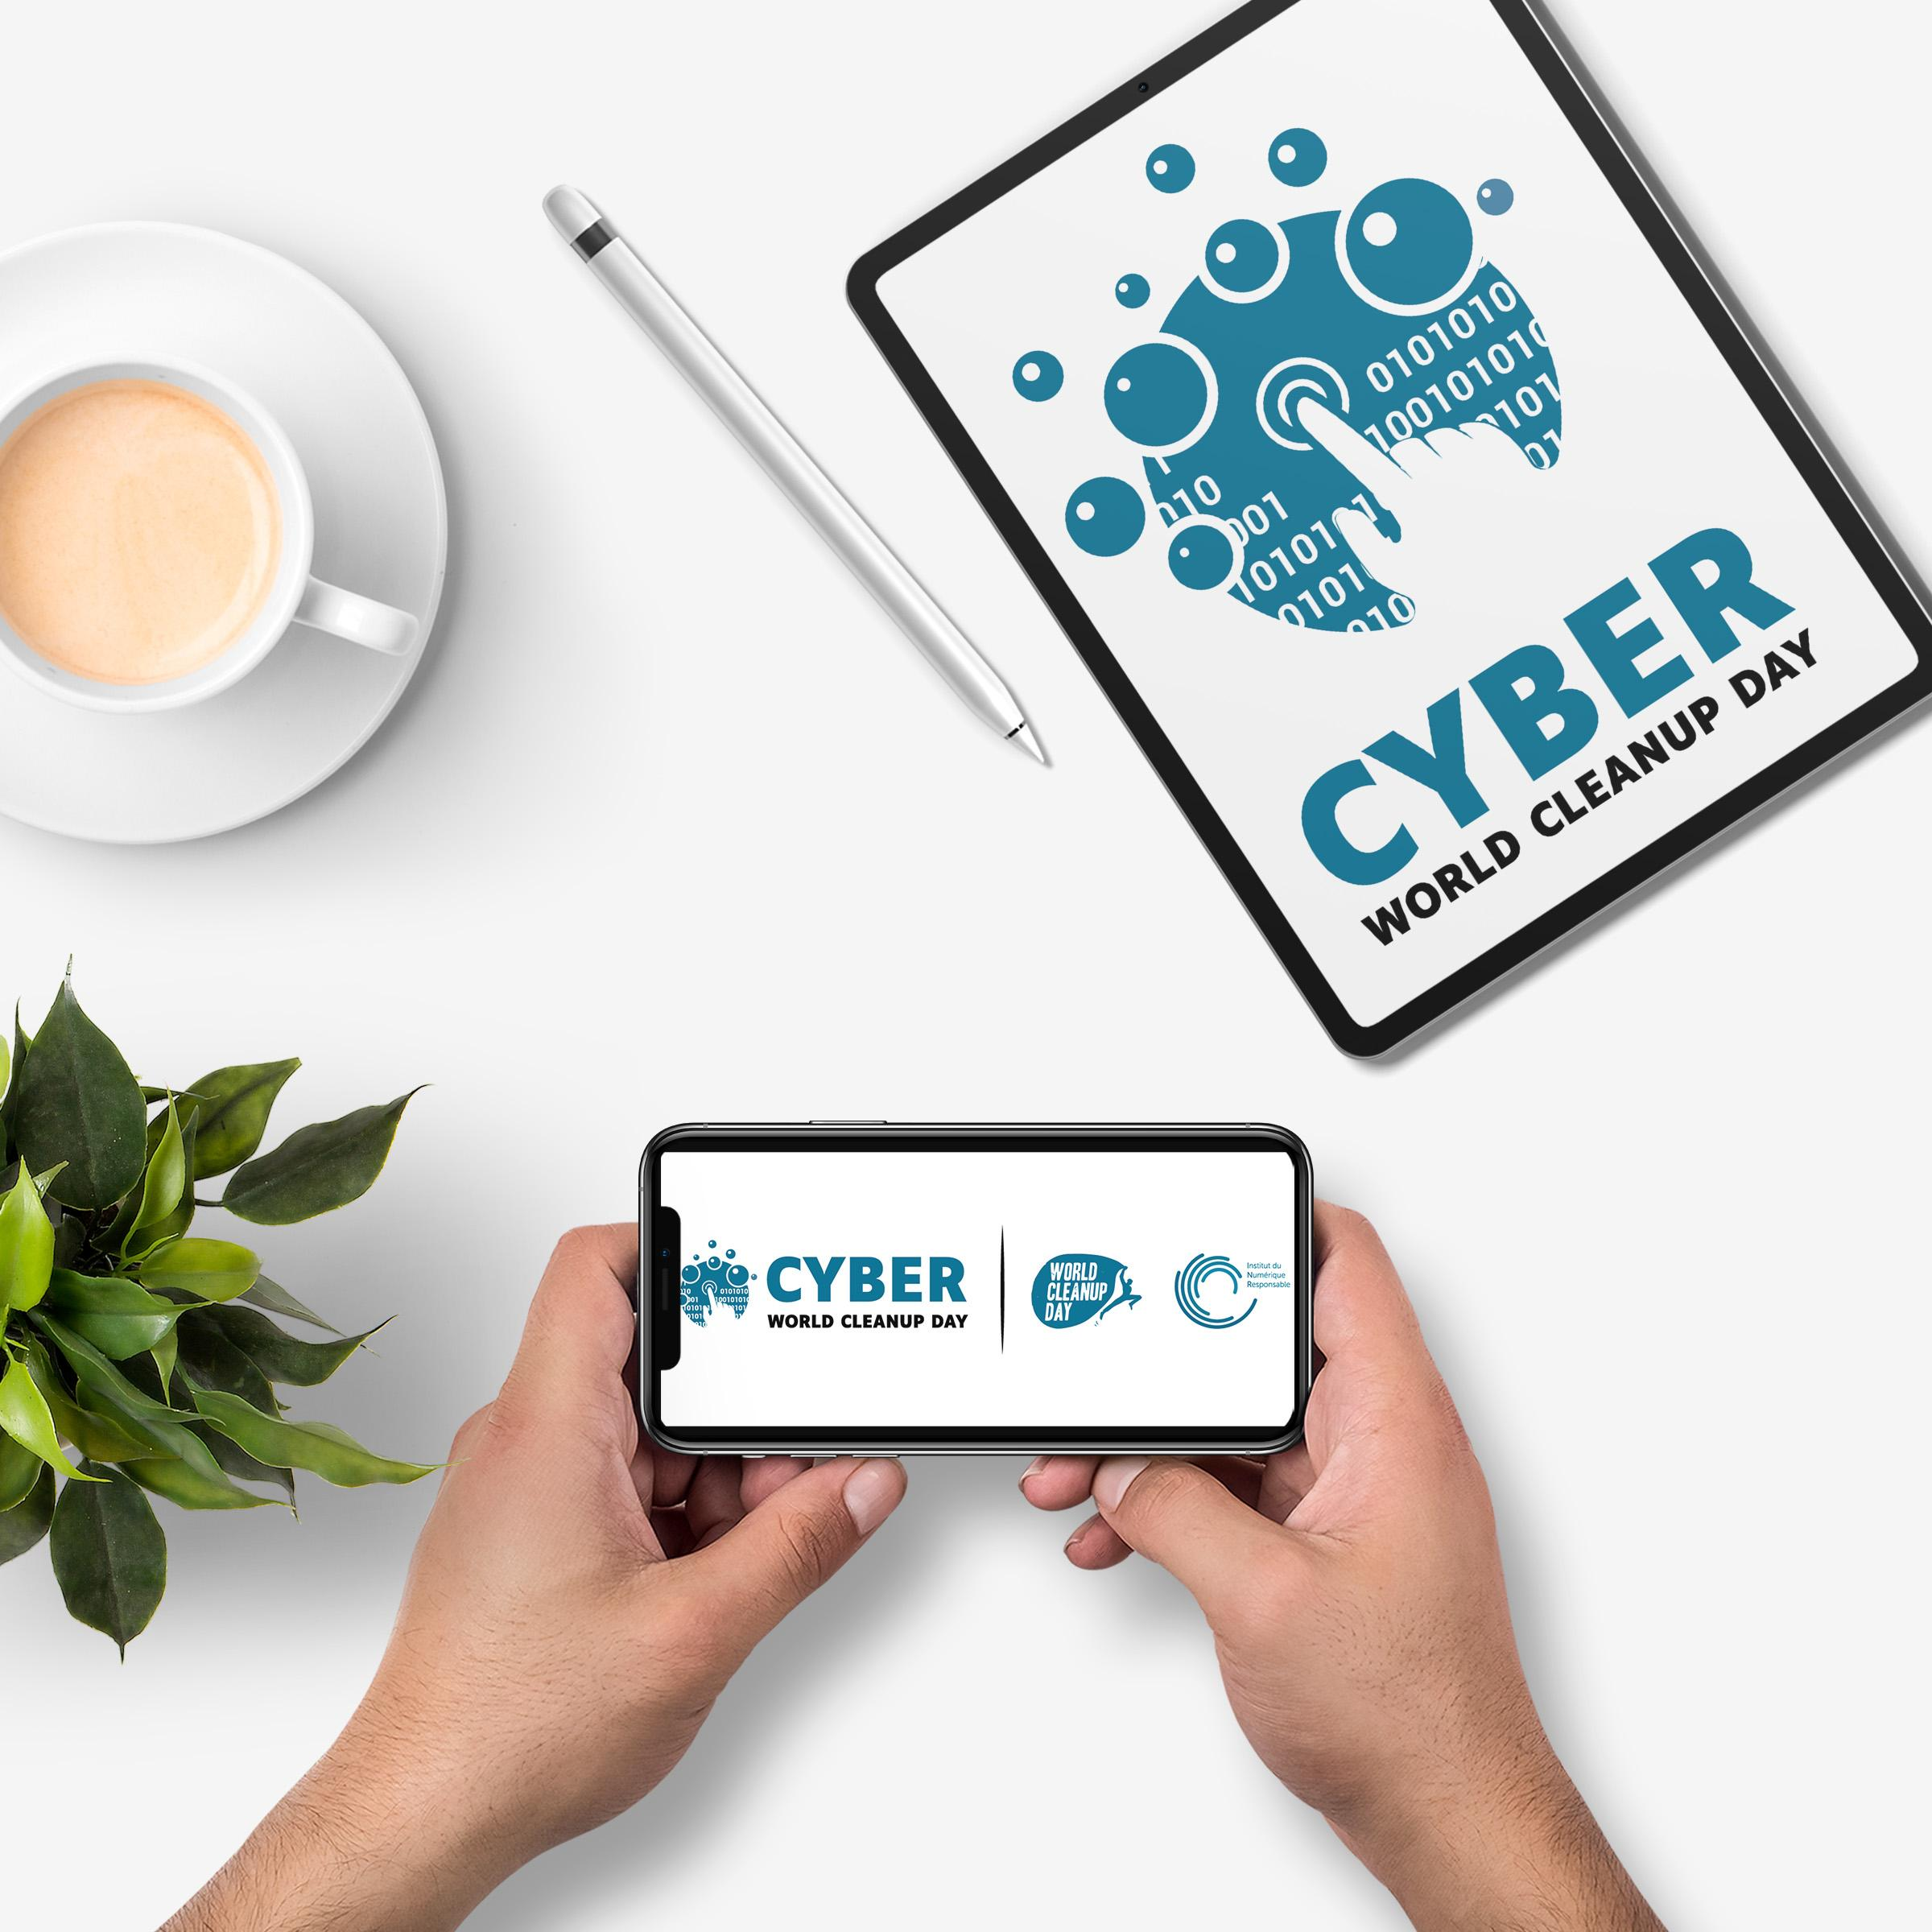
Let's clean up our mobile ?
Notes:
OK

Slide 30
For the impact measurement of the event, please indicate at the end of this exchange the number and weight of the data you have deleted !
To begin with, let's make a diagnosis of the space available on your mobile :
With Android
→ Settings > Storage to view the currently used storage space
With iOs
→ Settings > General > Storage
This allows you to see what takes up the most space on your mobile.
More in guide on cleaning smartphones & tablets
Notes:
OK

Slide 31
I Cleaning your mobile
Sort and delete my apps
Iphone & Ipad :
- Click on "iTunes Store and App Store" then check "Unload unused apps".
- Click on "Iphone/Ipad storage" to get a list of all your apps and you will see the date of your last use.
Android
1 - Open the Google Play Store application Google Play.
2 - Press Menu then My games and applications
3 - Press the application or game and press Uninstall
01
Sorting and organizing my files
1- Supprimer vos photos et vidéos floues, en double ou en triple, photos prises par accident etc
2 - Trier et supprimer les enregistrements, documents téléchargés etc devenus inutiles
3 - Faire une sauvegarde sur un disque dur externe (déconnecté du réseau ou PC lorsque vous n’en avez pas besoin)
02
Sort and delete my conversations
1 - Texting, WhatsApp, Messenger, Signal, Telegram etc
2 - Happy New Year messages from 2020,
3 - The text message, WhatsApp, Messenger that just says "I'm here" or gives a thumbs up.
4 - Useless conversations.
03
04
Delete temporary files
1 - Go to Settings then Storage
2 - Free up space by clicking on "Clean up".

Slide 32

To go further, lower my consumption
02
Learn to write lighter messages
Learn how to write your messages in lightweight mode (for example, do videos and photos sent with your smartphone need to be in High Definition?) and useful.
Selecting lighter applications
It is possible to choose applications that are less cumbersome and consume less power.
Facebook Lite,
Messenger Lite,
GoogleMaps Go…
01
03
Choisir sa connexion
1 - Favour the WIFI or Wired network rather than the mobile networks (3G, 4G).
2 - Switch off 4G as soon as you have finished your task. Disable mobile data when not in use.
3 - Remember to turn off your location, this avoids data transfers.
4 - Activate the data saver on your smartphone, it will prevent certain applications from receiving data in the background
And above all, take care of your equipment !
Notes:
OK

Slide 33
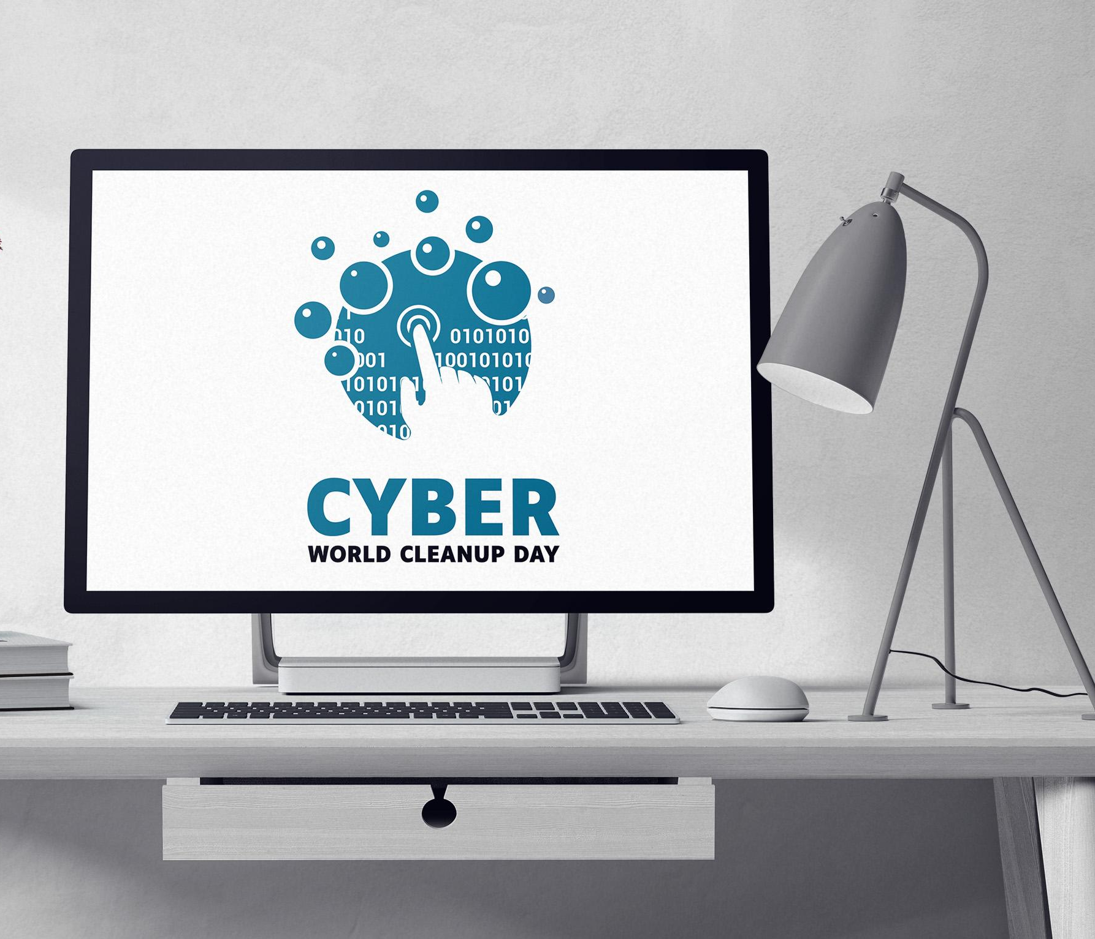
What if we cleaned our computer?
Notes:
OK

Slide 34
For the impact measurement of the event, please indicate at the end of this exchange the weight of the items you have deleted !
On a computer, we simply create a temporary directory "Cyber CleanUp" into which you will drag all the elements to be deleted. We will simply measure the final weight of this directory before permanently deleting the data.
On the cloud, the storage before/after cleaning is accurately recorded:
On OneDrive
→ Settings > Manage Storage
On Google Drive
→ Profile picture > Manage your Google Account > Storage space associated with your account > Manage storage space
To see what takes up the most space on your computer you can of course do the same:
On PC
→ Settings > System > Storage to view the used storage space
On Mac
→ Apple > About > Storage
More in the guide on cleaning computers & drives

Slide 35

Cleaning your computer
02
Sort and store my files
1 - Delete your blurred, duplicate or triple photos and videos, photos taken by accident etc.
2 - Sort and delete unnecessary recordings, downloaded documents etc. or obsolete file directories (old projects etc.) or duplicate files.
3 - Make a backup on an external hard drive (disconnected from the network or PC when you don't need it)
Sort and delete my files
1 - Open your files, ask yourself if they are still really useful? *
2 - Free your desktop and organize your files in folders to see them more clearly and spend less time looking for them
3 - And don't forget to empty the recycle bin of course
01
03
To go further
1 - Analyse the type of files to be deleted
2 - Identify best practices for organising your directories and backups to limit duplication
3 - Launch a disk cleanup
*In companies, we refer to the rules for the conservation of documents (RGPD rules), in communities, we check the date of administrative use and/or the historical interest.
Notes:
OK

Slide 36
I To go further -> best practices
Regularly clean up your outdated data
Keep only the essentials in the cloud and activate synchronisation only on the necessary folders
Take care of your computer : turn off your computer regularly and for all laptops use a reinforced sleeve when transporting it

Slide 37
For the impact measurement of the event, please indicate at the end of this exchange the number and weight of the data you have deleted !
For each participant, please indicate the number of files deleted and the size of the files in the Cyber CleanUp temporary folder. (MB..)
Once this is done, delete the directory and empty the recycle bin.
For the cloud, re-measure the storage space to identify the gain.
Notes:
OK

Slide 38
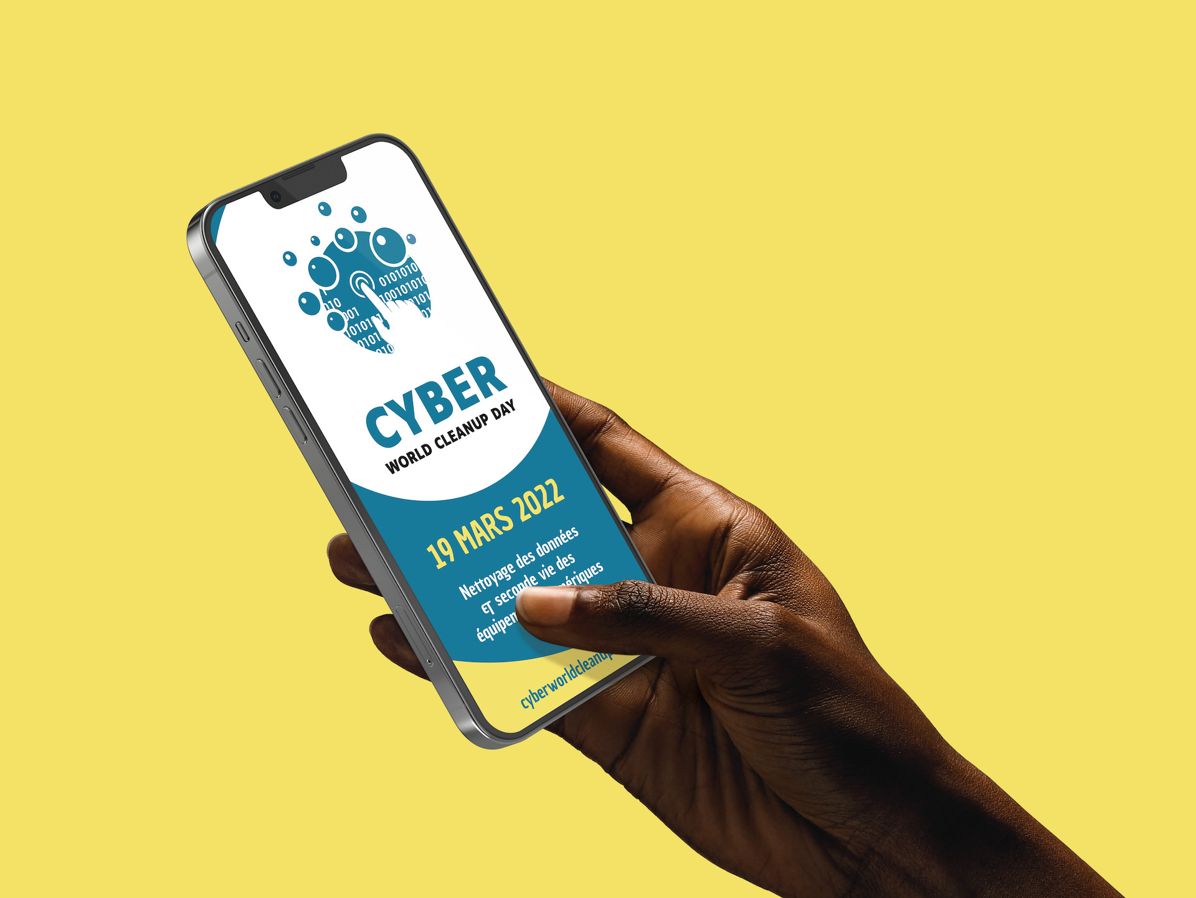
How about cleaning up our social media?
Notes:
OK

Slide 39
For the impact measurement of the event, please indicate at the end of this exchange an estimate of the type and number of data you have deleted!
On social media it is difficult to take action.
However, take note of the type of deleted items and their order of magnitude
(example: 100 publications / 1000 photos / 10 groups etc.)
More in the guide on cleaning up social networks
Notes:
OK

Slide 40
Clean up your social media
02
Sorting and organizing my files
1 - Go through your photos and videos and delete what you don't need to keep here
2 - Do the same for your group files for example
Delete my obsolete data
1 - Proceed in chronological order to delete your old publications
2 - Sort through your groups and pages to delete what is no longer relevant
01
03
Limiting the viewing of videos
1 - Disable automatic video playback
2 - Choose a lower resolution by default for video playback
3 - Prefer legal downloading to streaming
4 - Use a wifi or wired connection whenever possible
Notes:
OK

Slide 41
Action !
Cyber CleanUp Equipments
#CyberWCUD2022
Notes:
Bienvenue à toutes et tous,
Changement de date pour s’aligner avec l’international
Delai court pour cette nouvelle édition
Structuration autour de Pole pour intégrer de nouveaux bénévoles et répartir la charge de travail de chacun.

Slide 42
Why is it important to give our digital equipment a second life?
Cleaning your smartphone or your computer means lightening your equipment, improving its performance and extending its lifespan!
It also avoids producing new equipment: remember that 80% of the impact of digital technology is linked to the manufacture of new terminals!
Notes:
OK

Slide 43
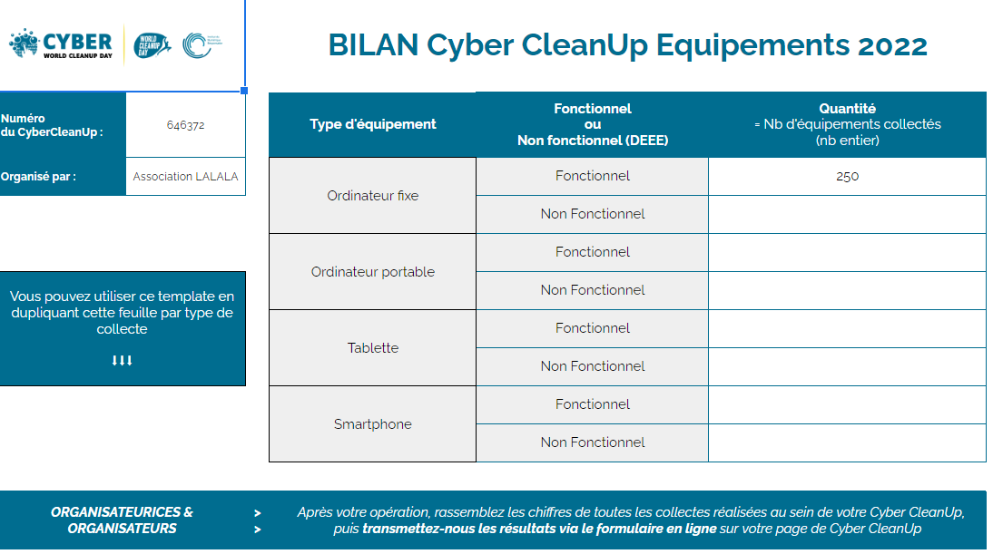
Et toujours
I Outcome
Data to be measured :
Number of functional equipment collected
desktop computers
laptops
tablets
smartphones
Number of non-functional equipment collected
desktop computers
laptops
tablets
smartphones
Notes:
OK

Slide 44

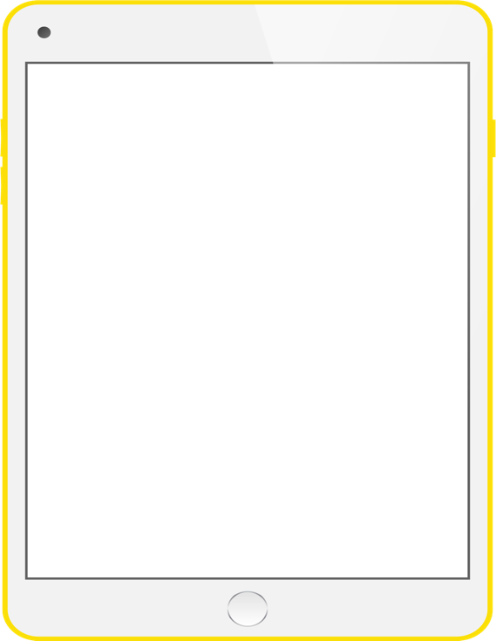
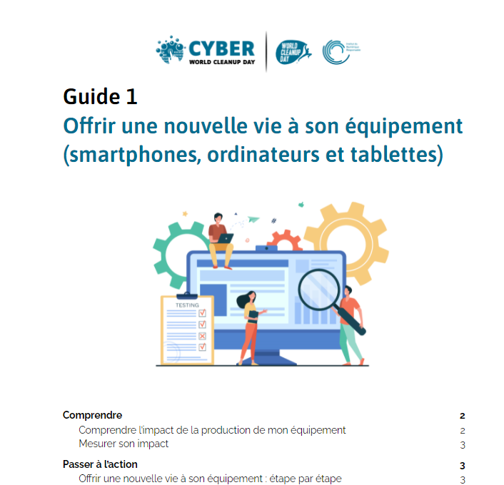
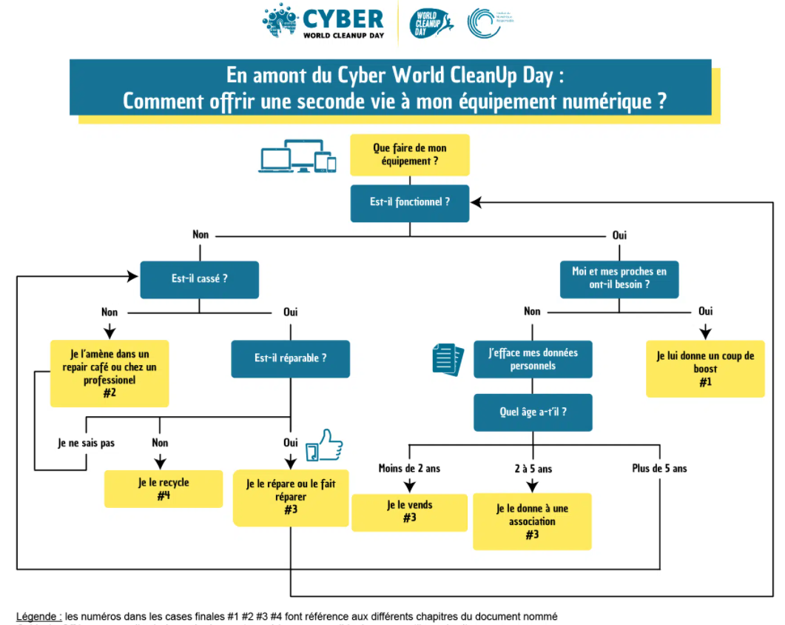
I The guidebooks
I New guides in English AND French are available detailing how to give your equipment a second life.
Giving new life to your digital equipment :
Giving a boost
Repairing your equipment
Encourage re-use
Recycle your equipment
Where to find them?
cyberworldcleanupday.fr > CyberWCUD Space > my tools

Slide 45
Good practices according to the evaluation of its equipment.
1# Give your equipment a boost
I Remember to uninstall unused software / applications
Guidebook 3_ Clean up your computer and drive
Guidebook 4_ Cleaning your smartphone and tablet
I Faites le tri dans vos données sur :
Guidebook 5_ Clean up your emails
Guidebook 6_ Clean up your social media
I If needed reset your device (format or reset to factory settings) with the help of someone you know or by watching tutorials.
I Another solution may be to switch to an open source operating system that is less resource intensive (e.g. Linux for computers and/or smartphones).

Slide 46
Good practices according to the evaluation of its equipment.
2# Repaire your equipment
I Is your equipment no longer holding the battery or is the screen cracked? Does it need to be replaced in its entirety? There are many ways to repair it.
I Repair yourself your equipment with online tutorials.
I Get help at a repair café. It is a workshop dedicated to the repair of objects and organised at a local level thanks to volunteers, there is surely one near you.
I Or look for a professional to accompany you.

Slide 47
Good practices according to the evaluation of its equipment.
3# Promoting re-use
I Your equipment is still functional but may no longer meet your needs. It may still be useful to someone with different expectations or for other less resource-intensive uses.
I Once you have recovered and deleted your data, you can donate your device to a relative or acquaintance, or sell it on an online marketplace or to a professional who buys your second-hand equipment near you.

Slide 48
Good practices according to the evaluation of its equipment.
4# Recycle
I If your appliance is non-functional or non-repairable, it must be treated as Waste Electrical and Electronic Equipment (WEEE). It will then be dismantled, the materials sorted and recycled as far as possible.
I Favour drop-off points near your home to limit long-distance shipments and boost the local ecosystem.

Slide 49
Well done to you for your Cyber CleanUp!
I Communicate your assessment on your social media (#CyberWCUD)
Vous souhaitez aller plus loin ou vous former au numérique responsable ?
I Take part in the MOOCS offered by the INR (via : https://cyberworldcleanupday.fr/train-myself/)
I Give your testimony on contact@cyberworldcleanupday.fr
I Become an ambassador (https://cyberworldcleanupday.fr/ambassador/become-ambassador/)

Slide 50
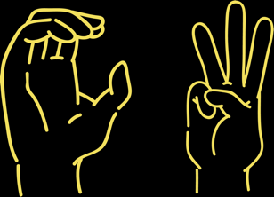
See you on 18 March 2023
for the next edition !

